Slide 1

https://aceiciate.in/conf.php
Paper Id / Submission Id : 68
Paper Title: TeenHub – Recommendation System
College Name: Atharva College of Engineering
Authors Name: Pranav Jain,
Kedar Kale,
Ganesh Choudhary,
Paresh Aher,
Deepali Maste

Slide 2
TeenHub Recommendation System

Slide 3
1. Abstract
By
Kedar Kale

Slide 4
The concept of TeenHub falls into two domains: Machine Learning and Advanced Web Application.
In TeenHub, the aim is to visualize the Machine Learning algorithms on the web applications by using smart data visualization tools, algorithms and techniques and not limiting them to just run onto terminals.
It will be an all in one package for entertainment news and ratings.

Slide 5
2. Aim & Objective
By
Kedar Kale

Slide 6
The aim of this project is to provide a one place solution for all entertainment needs of users of all age group.
The objectives are:
To implement recommendation engine for movies, songs and games.
To implement a custom search engine.
To design a responsive design for the web application.
To implement a dashboard for the users to view their activities.

Slide 7
3.Introduction
By
Kedar Kale

Slide 8
On the Internet, where the number of choices is overwhelming, there is a need to filter, prioritize and efficiently deliver relevant information in order to alleviate the problem of information overload, which has created a potential problem to many Internet users.
Recommender systems solve this problem by searching through large volume of dynamically generated information to provide users with personalized content and services.

Slide 9
4. Review of Literature
By
Kedar Kale

Slide 10
A number of techniques have been proposed to solve the problem of filtering and recommendation. They are explained briefly as follows

Slide 11
A. Content-Based Filtering
The system here tries to recommend items which are similar to the items which were liked by the given user in the past.
Past activity is heavily used in content-based recommender systems.
Content-based recommender system will try to comprehend the similarities among the items that an user has rated highly in the past.
Then, using the similarities a list of items is generated.

Slide 12
B. Collaborative Filtering
Collaborative filtering predicts items for particular user based on items rated by other users.
It makes prediction about the interests of user by collecting preference from many users.
Collaborative filtering based recommender systems focus on algorithms for matching people based on their opinion (likes or dislikes, preferences, ratings etc.).

Slide 13
5. Proposed System
By
Pranav Jain

Slide 14
The proposed system has three main components:
Recommendation Engine:
This engine is responsible for making recommendations for the user.
It is common to all three sections: Movies, Songs and Games.
It uses item-based collaborative filtering to make recommendations in the backend.
It then passes these recommendations to the frontend which is showed to the user.

Slide 15
Dashboard:
This is a private space for the user. Here, the user can view, edit all their activities done in the past.
Future application updates and recent changes made in the application are also displayed here.
Privacy is very important at TeenHub and here user can give permission to the application to give access to user’s data.

Slide 16
Search Engine:
This engine is responsible for making accurate search results from user entered search queries.
It heavily relies on TF-IDF algorithm.
TF-IDF is a numerical statistic that is intended to reflect how important a word is to a document in a collection.

Slide 17
6. Results
By
Pranav Jain

Slide 18

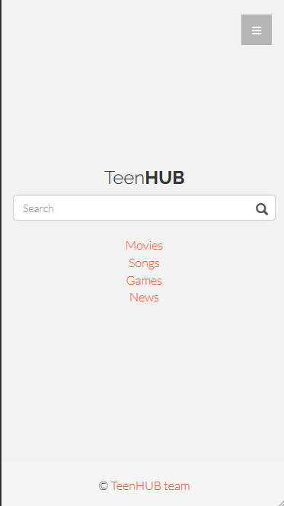
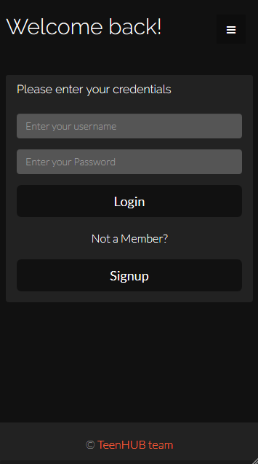
Smartphone

Slide 19
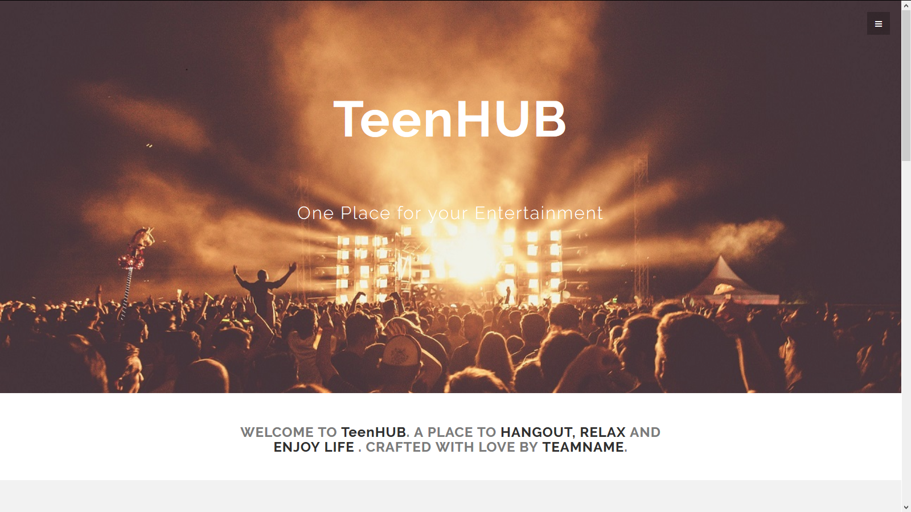

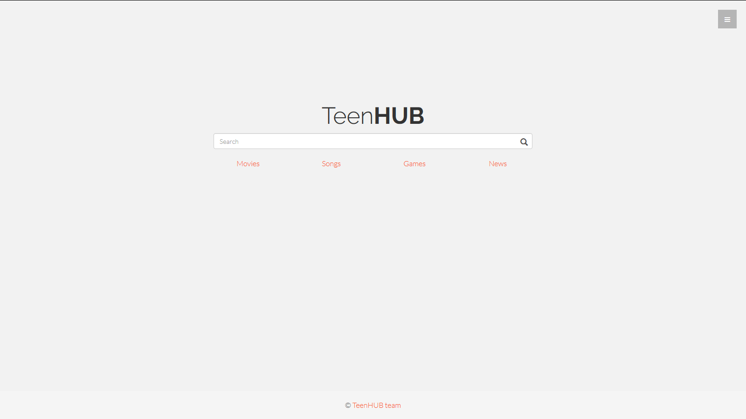
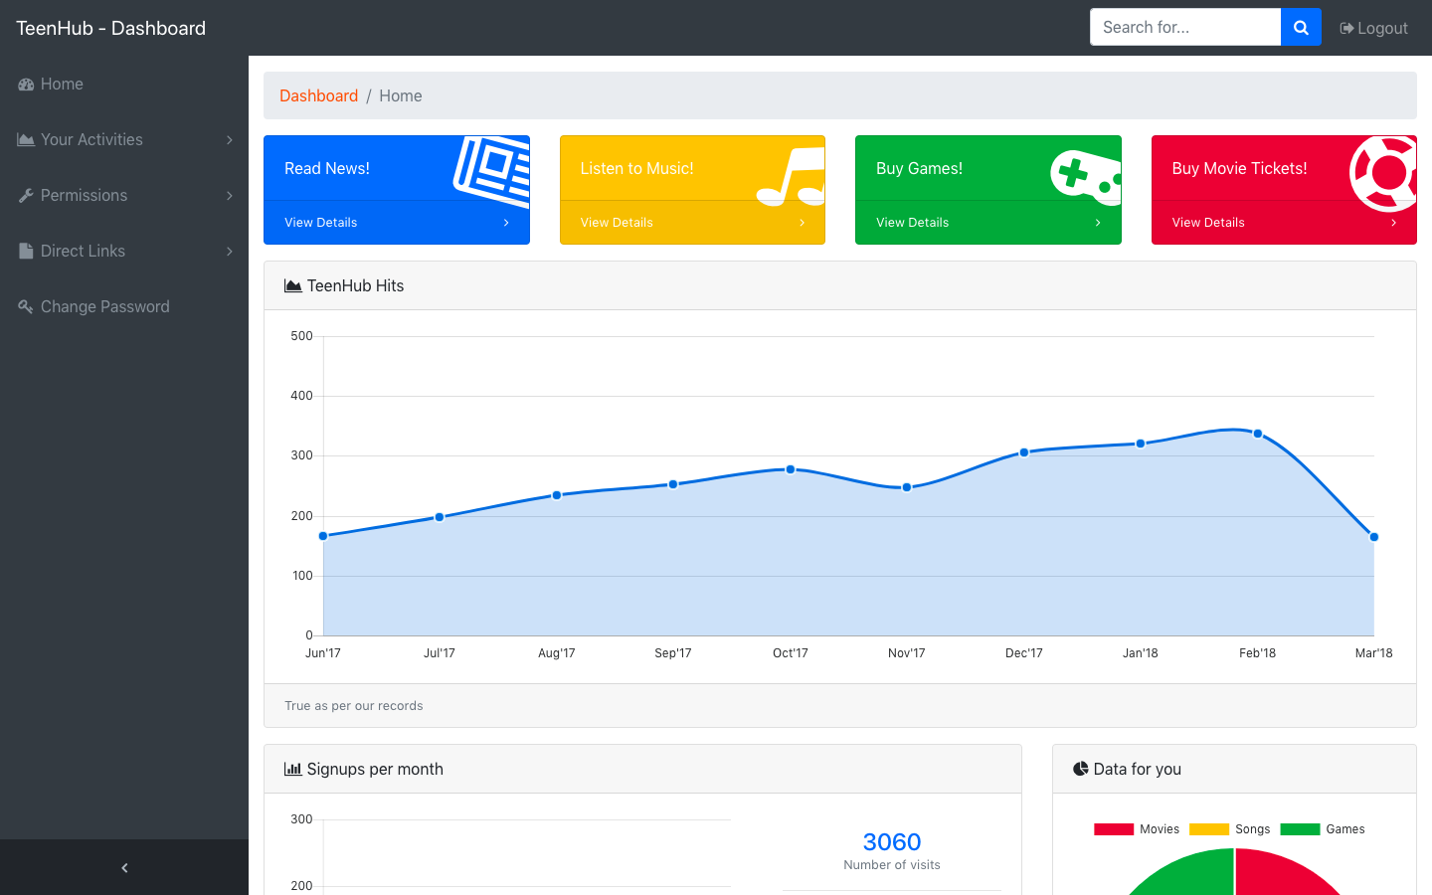
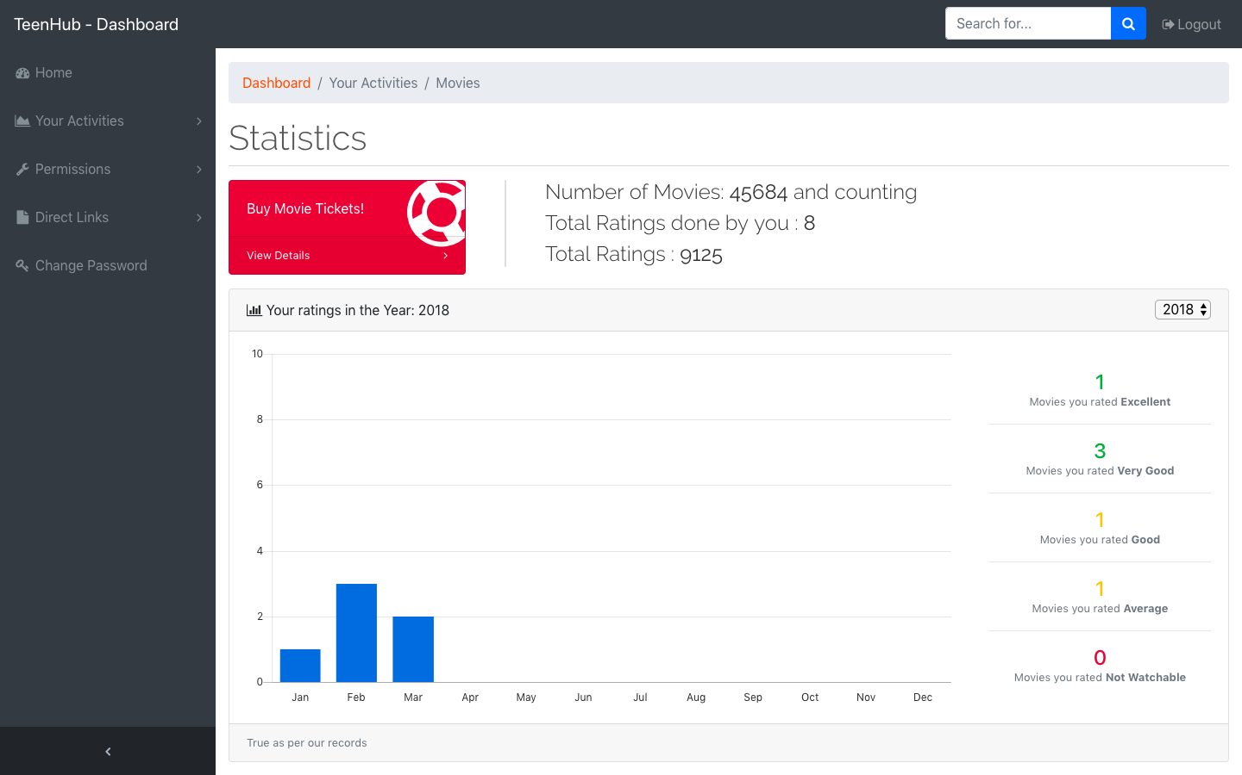
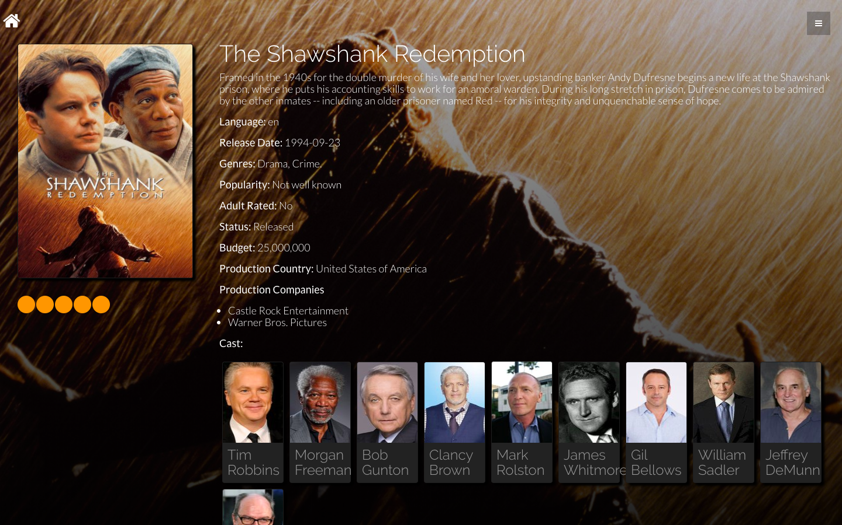
Desktop

Slide 20
7. Conclusion
By
Pranav Jain

Slide 21
The users will have one common login for all the 4 parts. The user can login as a guest or make an account for self.
Users will get a dashboard to see their own data and activities on interactive charts.
The recommendation engine will recommend the user movies based on his/her previous ratings for movies.
A news app is also included to keep the user updated with the latest of news in the entertainment industry.

Slide 22
8. References

Slide 23
[1] DietmarJannach and Simon Fischer, Recommendation-based Modeling Support for Data Mining Processes, Germany and Simon Fischer Rapid Miner GmbH, Germany, Proceedings of the 8th ACM Conference on Recommender system, pages 337-340, October 2014.
[2]Ali Heydarzadegan, Yaser Nemati, Mohsen Moradi, Evaluation of Machine Learning Algorithms in Artificial Intelligence, IJCSMC, Vol. 4, Issue. 5, May 2015, pg.278 – 286
[3]Tian Xia, Yanmei Chai, An Improvement to TF-IDF: Term Distribution based Term Weight Algorithm, JOURNAL OF SOFTWARE, VOL. 6, NO. 3, MARCH 2011
[4] Ramos, Juan. (2003). Using TF-IDF to determine word relevance in document queries.
[5]G. Linden; B. Smith; J. York, Amazon.com recommendations: item-to-item collaborative filtering, IEEE Internet Computing ( Volume: 7, Issue: 1, Jan/Feb 2003 ), pages 76-80

Slide 24
[6]Michael J. Pazzani, Daniel Billsus. “Content-Based Recommendation Systems”. Springer-Verlag Berlin Heidelberg 2007. doi: 10.1007/978-3-540-72079-9_10
[7]Marko Balabanovic, Yoav Shoham. “Content-Based, Collaborative Recommendation”. Communications of the ACM, Volume 40 Issue 3, March 1997, Pages 66-72. doi: 10.1145/245108.245124
[8] Adomavicius, G.; Tuzhilin, A. (June 2005). "Toward the Next Generation of Recommender Systems: A Survey of the State-of-the-Art and Possible Extensions". IEEE Transactions on Knowledge and Data Engineering. 17 (6): 734-749. doi:10.1109/TKDE.2005.99
[9]Terveen, Loren; Hill, Will (2001). "Beyond Recommender Systems: Helping People Help Each Other" (PDF). Addison-Wesley. p. 6. Retrieved 16 January2012.
[10]Shweta Taneja, Charu Gupta, Kratika Goyal, Dharna Gureja. (February 2014). “An Enhanced K-Nearest Neighbor Algorithm Using Information Gain and Clustering”. Advanced Computing & Communication Technologies (ACCT). doi: 10.1109/ACCT.2014.22

Slide 25
Thanks!
Any questions?
The project can be found at:
https://github.com/pranavj1001/TeenHub

